Slide 1
CS 4700:
Foundations of Artificial Intelligence
Prof. Bart Selman
selman@cs.cornell.edu
Machine Learning:
Neural Networks
R&N 18.7
Backpropagation

Slide 2
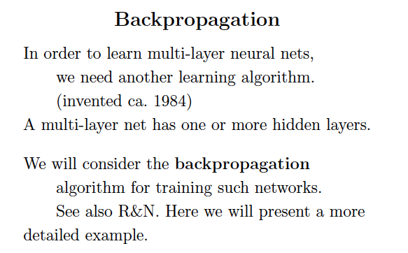

Slide 3
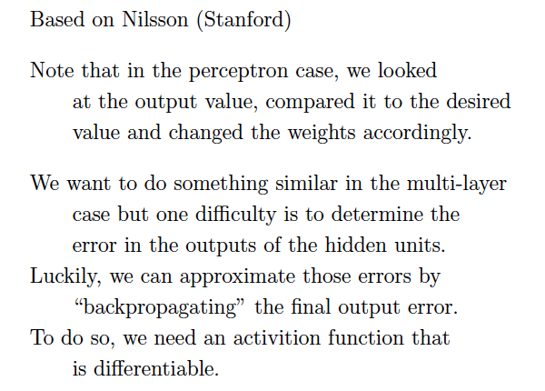

Slide 4
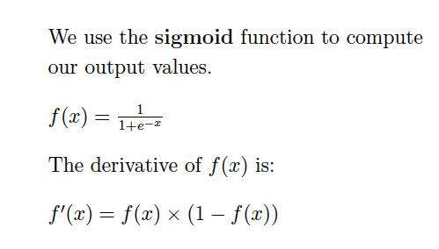

Slide 5

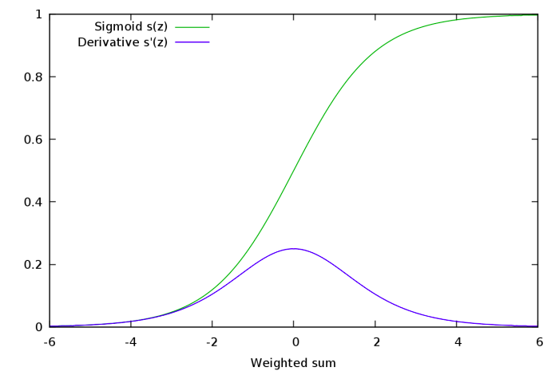
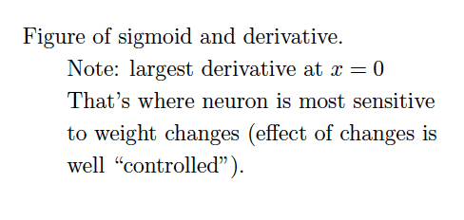

Slide 6
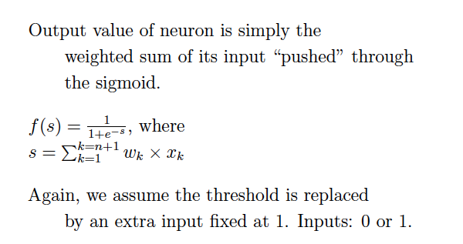

Slide 7
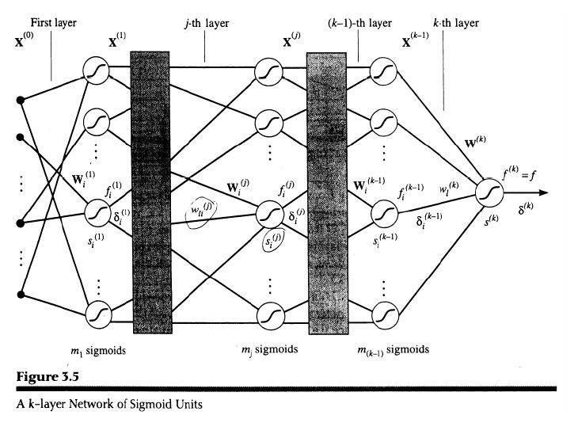

Slide 8
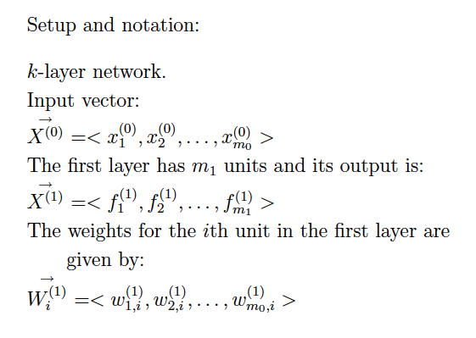
Ok… details backpropagation NOT on exam.
But do work through gradient descent example on homework.

Slide 9
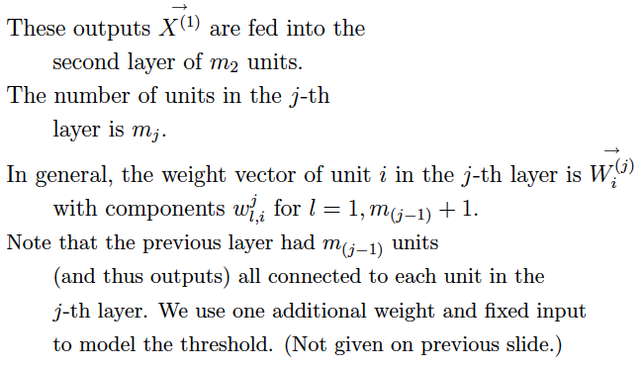

Slide 10
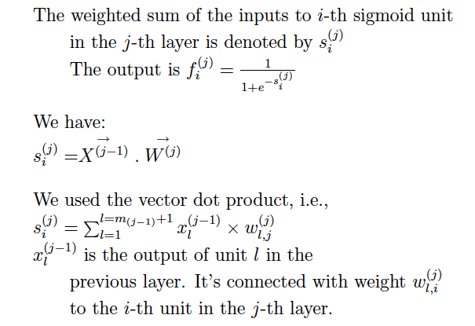

Slide 11
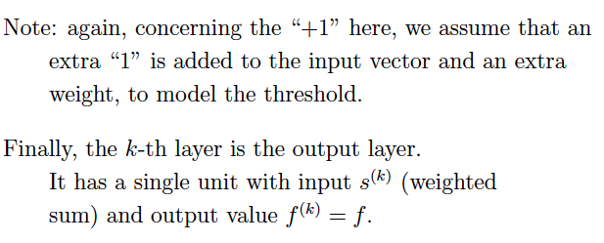

Slide 12
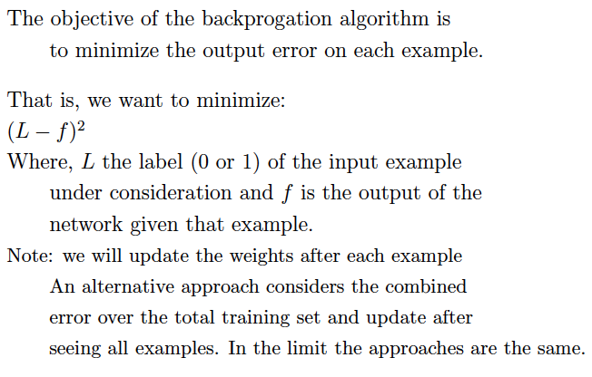

Slide 13
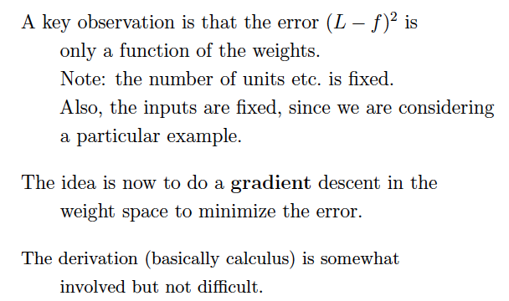
It’s “just” multivariate (or multivariable) calculus.

Slide 14
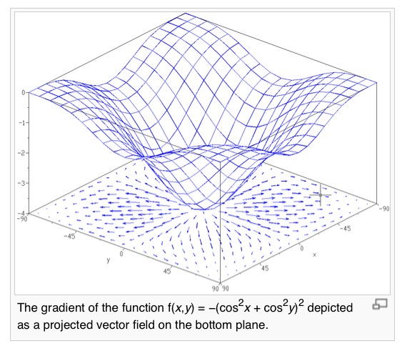

Note:
For descent
we want to
go in opposite
direction of
gradient.
Optimization
and
gradient descent.
Consider
x and y our
two weights
and f(x,y)
the error
signal.
Multi-layer
network:
composition
of sigmoids;
use chain rule.

Slide 15
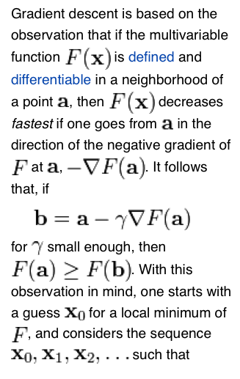
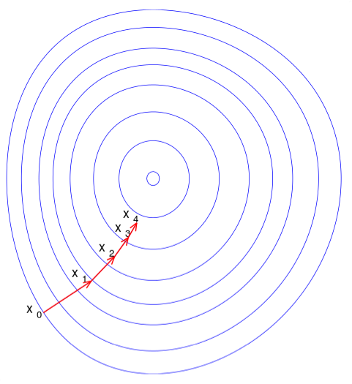
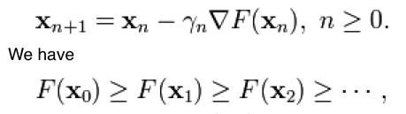
Reminder:
Gradient descent optimization.
(Wikipedia)

Slide 16
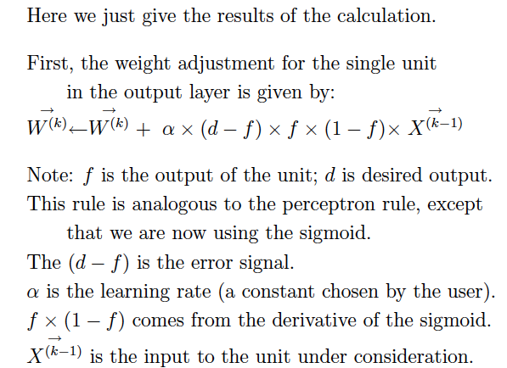

Slide 17
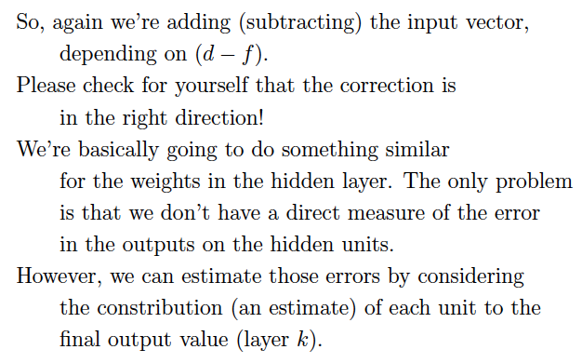

Slide 18
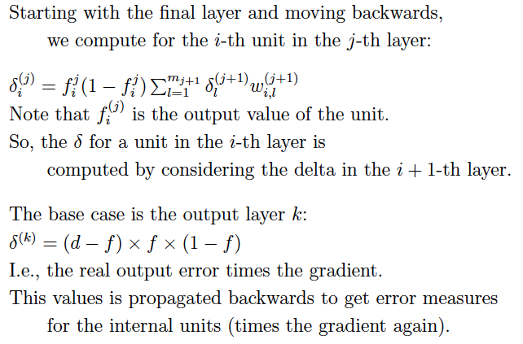

Slide 19
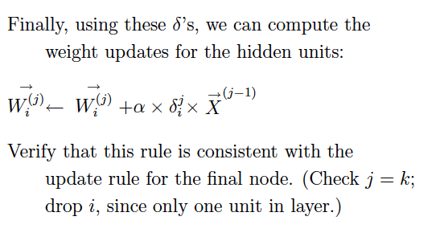
So, first we “backpropagate” the error
signal to get the gradient, and then we update the weights,
layer by layer.
That’s why it’s called “backprop learning.”
Now changing speech recognition, image
recognition etc.!

Slide 20
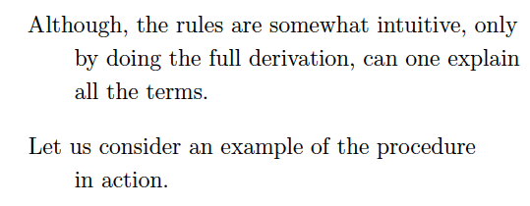

Slide 21
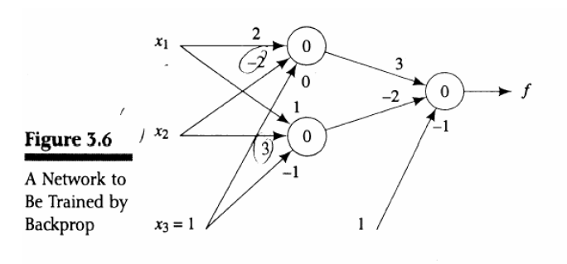
Trace example!

Slide 22
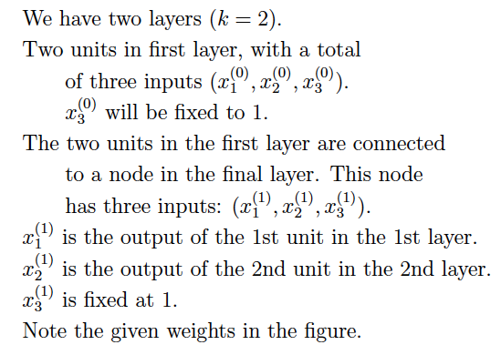

Slide 23
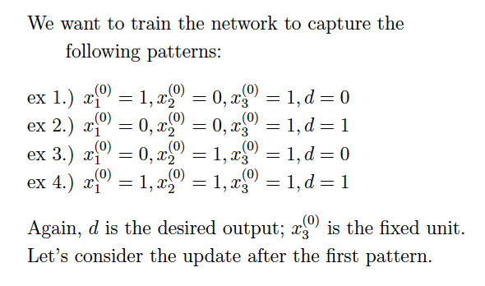

Slide 24
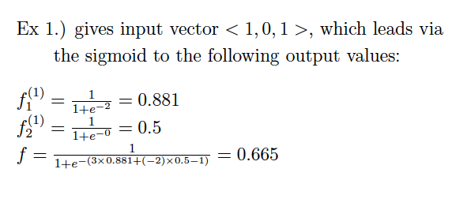

Slide 25
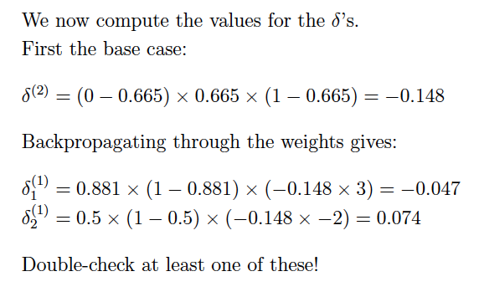

Slide 26
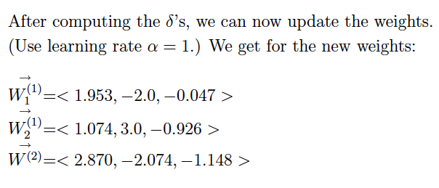

Slide 27
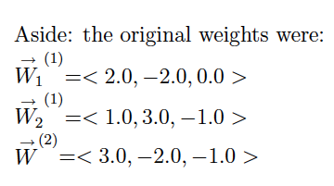

Slide 28
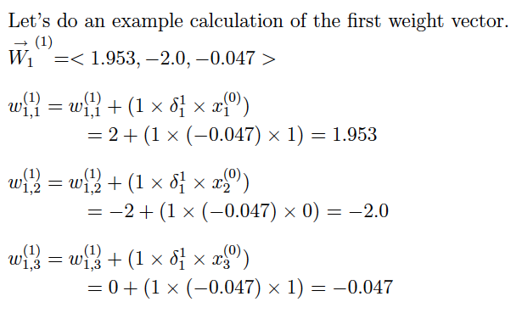

Slide 29
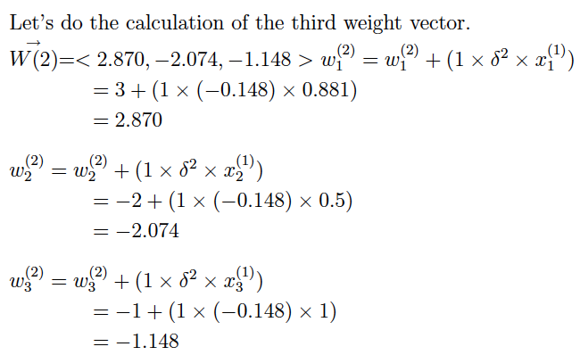
Etc.
Tedious but
“just” gradient
descent in the
weight space,
after all.

Slide 30
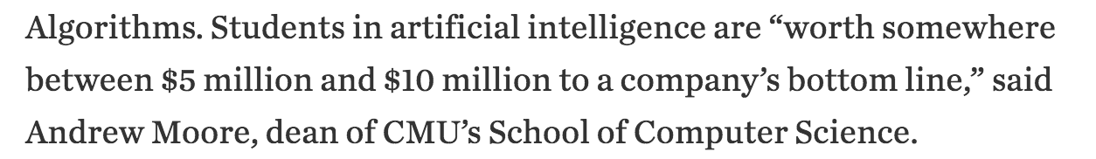
Good news…
Bla bla
Wall Street Journal, 11/24/16

Slide 31
Summary ☺
A tour of AI:
AI
--- motivation
--- overview of the field
Problem-Solving
  ---- problem formulation using state space
  (initial state, operators, goal state(s))
  --- search techniques
--- adversarial search
White white

Slide 32
Summary, cont.
III) Knowledge Representation and Reasoning
--- logical agents
--- Boolean satisfiability (SAT) solvers
--- first-order logic and inference
Learning
  --- decision tree learning (info gain)
--- reinforcement learning (intro)
--- neural networks / deep learning (gradient descent)
The field has grown (and continues to grow) exponentially but you
have now seen a good part!
Thanks & Have a great winter break!!!!

